Slide 1
Bubble Sort

Slide 2
Algorithm for sorting an array (Bubble sort)
(Bubble sort) BUBBLE (DATA, N)
Here DATA is an array with N elements. This algorithm sorts the elements in DATA.
1. Repeat Steps 2 and 3 for K = 1 to N – 1.
2. Set PTR := 1. [Initialize pass pointer PTR.]
3. Repeat while PTR <= (N – K): [Executes pass.]
(a) If DATA[PTR] > DATA[PTR + 1], then:
Interchange DATA[PTR] and DATA[PTR + 1].
[End of If structure.]
(b) Set PTR := PTR + 1.
[End of inner loop.]
[End of Step 1 outer loop.]
4. Exit.

Slide 3
Complexity of Bubble sort
f(n) = (n-1)+(n-2)+ ….+ 2+1=n(n-1)/2=(n^2)/2+O(n)=O(n^2)

Slide 4
Another aspect of Bubble sort
I:=1 [Initialize pass counter]
FLAG:=False [Initialize Flag to execute Pass 1]
Repeat steps 4 to while I<=N-1 and Flag=false
Flag:=True [assume no interchange occur in current pass]
Repeat steps 6 for J=1 to N-I-1 [execute pass]
If (A[J]>A[J+1]) then
a) Interchange A[J] and A[J+1]
b) Flag:= False [Indicates next pass will execute]
[End of If Structure]
[End of Inner Loop]
I:=I+1 [Increment pass counter]
[End of step3 outer Loop]
8 Return

Slide 5
Insertion Sorting
A sub-list is maintained which is always sorted.
A element which is to be 'insert'ed in this sorted sub-list, has to find its appropriate place and insert it there. Hence the nameinsertion sort.
The array is searched sequentially and unsorted items are moved and inserted into sorted sub-list (in the same array).

Slide 6
Suppose an array A with n elements A[1], A[2]…..A[N] is in memory.
The insertion sort scans A from A[1] to A[N], inserting each element A[K] into its proper position in the previously sorted sub array.

Slide 7
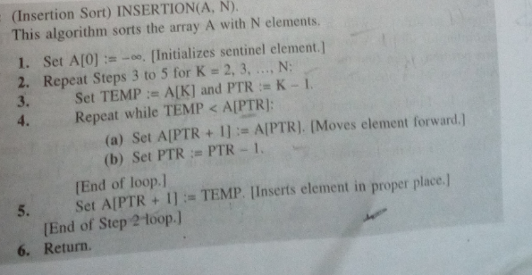

Slide 8
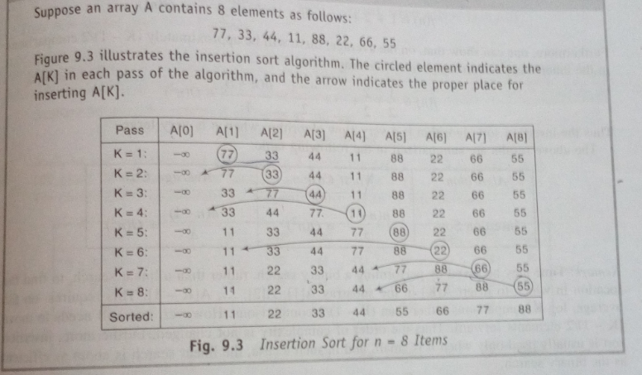

Slide 9
Selection Sorting
Suppose an array A with n elements A[1], A[2]…..A[n] is in memory.
The selection sorting works by finding the smallest element in the list and put it in the first position. Then the second smallest element in the list is searched and put it in the second position.
And so on.

Slide 10
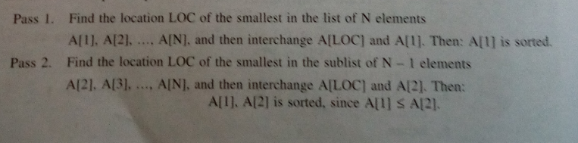

Slide 11
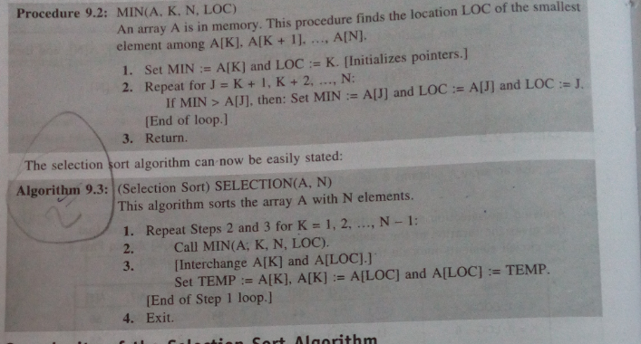
Selection Sorting

Slide 12
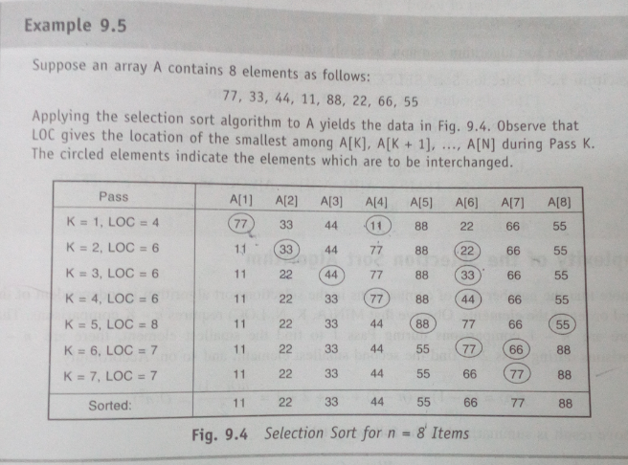

Slide 13
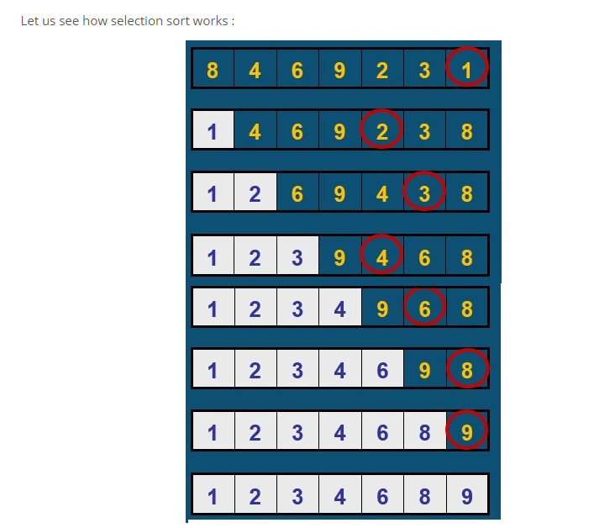
Working of selection sort

Slide 14
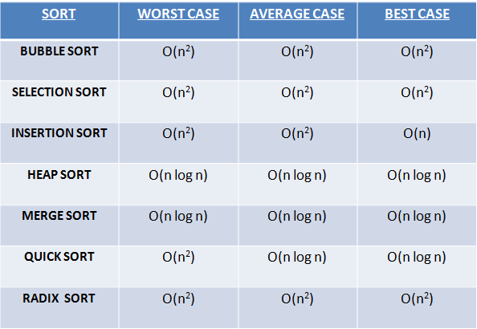
COMPLEXITY ANALYSIS

